Slide 1
Presented by: Parveen Sood Kevin Mouofo Gvs Goutham Jason Yeoh Rishikesh Jangam
Supervised by: Adam McElhinney
DATA PREPARATION AND ANALYSIS
2020

Slide 2


1
PROBLEM BACKGROUND AND DESCRIPTION

Slide 3

2
DATA :
IDENTIFICATION
COLLECTION
EXPLORATORY AND ANALYSIS
CLEANING

Slide 4
DATA IDENTIFICATION AND COLLECTION

Slide 5
EXPLORATORY AND DATA ANALYSIS

Slide 6
DATA CLEANING

Slide 7


Slide 8

3
MODELING :
MODELS CHOSE AND WHY
LINEAR REGRESSION
K NEAREST-NEIGHBORS
LASSO
NEURAL NETWORK
COMPARISON

Slide 9
MODELS CHOSE AND WHY

Slide 10
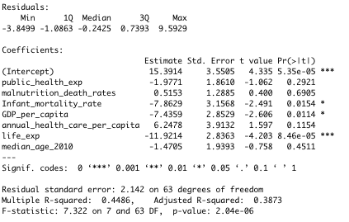
LINEAR REGRESSION MODEL
Standard Linear Regression was performed to assess the ability of our independent variables to predict the homicide rate. After the data cleaning, preliminary analysis were performed to ensure there was no violation of the normality and the linearity.
Linear relationship
Test data
R**2 : 0.987076
RMSE : 3.700107
MAE : 2.679041

Slide 11
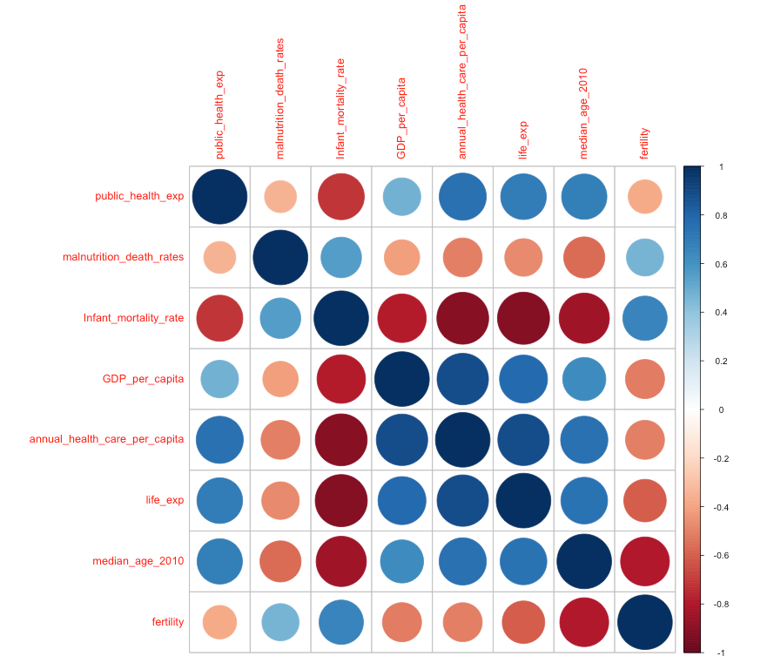
LINEAR REGRESSION MODEL
2. Multicollinearity

Slide 12
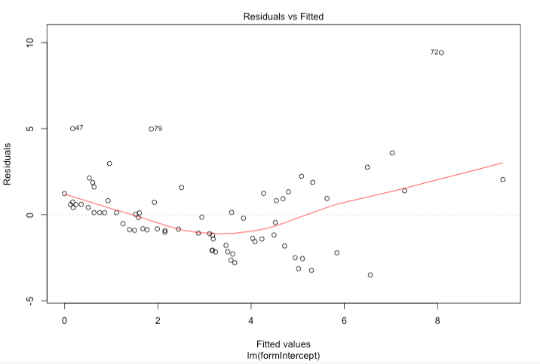
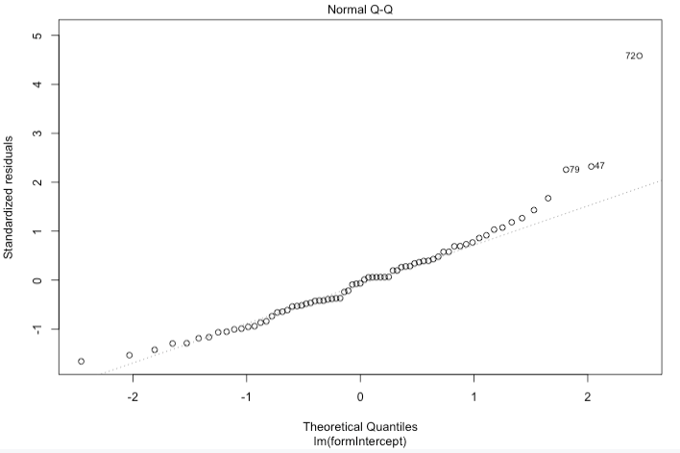
LINEAR REGRESSION MODEL

Slide 13
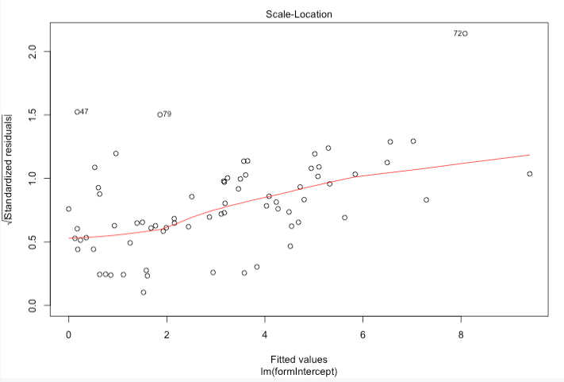
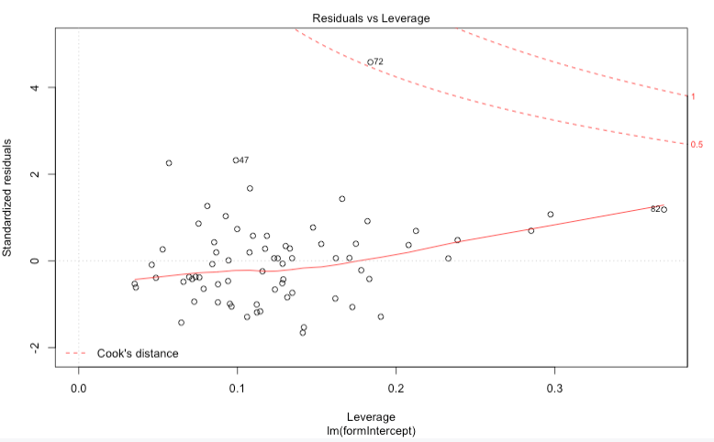
LINEAR REGRESSION MODEL
4. Autocorrelation

Slide 14
LINEAR REGRESSION MODEL
5. Results, interpretation and improvement
After trying several techniques and combination n of techniques to boost the performance of our linear regression model such as log transformation, range normalization, stepwise variable selection, adding intercept. We have used 10 fold cross validation to confirms that our best linear regression model, uses a range normalization and the intercept.
We have RMSE, and R**2 as validation metrics. We have the following results : (I am working on a diagram for this part)
As you can see from our RMSE our linear regression model has a mean square error of about … To improve it, we saw that more variables can slightly reduce the error in the prediction. Another alternative is to ...
Notes:
After trying several techniques and combination n of techniques to boost the performance of our linear regression model such as log transformation, range normalization, stepwise variable selection, adding intercept. We have used 10 fold cross validation to confirms that our best linear regression model, uses a range normalization and the intercept.

Slide 15
LINEAR REGRESSION MODEL
5. Results, interpretation and improvement
After trying several techniques and combination n of techniques to boost the performance of our linear regression model such as log transformation, range normalization, stepwise variable selection, adding intercept. We have used 10 fold cross validation to confirms that our best linear regression model, uses a range normalization and the intercept.
We have RMSE, and R**2 as validation metrics. We have the following results : (I am working on a diagram for this part)
As you can see from our RMSE our linear regression model has a mean square error of about … To improve it, we saw that more variables can slightly reduce the error in the prediction. Another alternative is to ...
Notes:
After trying several techniques and combination n of techniques to boost the performance of our linear regression model such as log transformation, range normalization, stepwise variable selection, adding intercept. We have used 10 fold cross validation to confirms that our best linear regression model, uses a range normalization and the intercept.

Slide 16
K NEAREST NEIGHBORS MODEL

Slide 17
LASSO MODEL

Slide 18
NEURAL NETWORK MODEL

Slide 19
RESULTS COMPARISON (ADD PRECISION RECALL ETC)

Slide 20

4
DEMO

Slide 21

5
PROJECT DIFFICULTIES AND OUTCOMES

Slide 22
PROJECT DIFFICULTIES AND SOLUTIONS

Slide 23
PROJECT OUTCOMES

Slide 24
THANK YOU FOR YOUR KIND ATTENTION !

